Slide 1
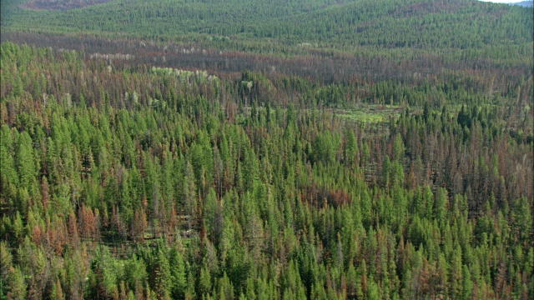
The Roles of Geographic Location, Introduction Status, and Host Species in Structuring Fungal Endophyte Communities
Erik Parker and Savannah Bennett
Quantitative Biodiversity
Spring 2017

Slide 2
Personal Motivations
Ecological Motivations
Soil microbes often attributed to invasion success
Few studies have investigated microbial diversity in native/introduced systems
Evolutionary Motivations
Are plant endophyte communities structured in a way consistent with their evolutionary history?
Diversity of host species, habitats, and introduction status here provides compelling data

Slide 3
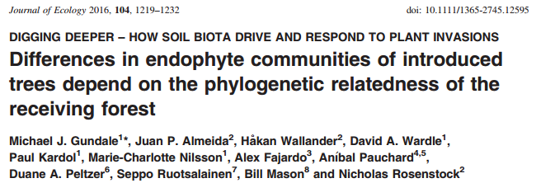

Slide 4
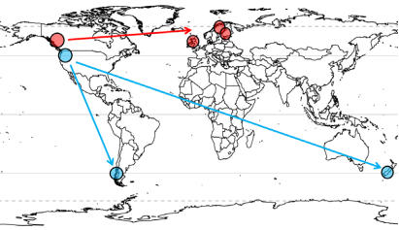
Background
Fungal endophyte OTUs from Pinus contorta (lodgepole pine) and other tree species
Collected data from 7 sites where P. contorta is native and introduced
Native:
USA
Canada
Introduced:
New Zealand
Chile
Finland
Scotland
Sweden

Slide 5
Background
Determined endophyte OTUs for phylogenetically similar (Pinus sylvestris in Europe) and dissimilar (Nothophagus spp.) species
Total of 61 samples, 769 OTUs (EMF, saprotrophs, parasites, unknowns)

Slide 6
Our Hypotheses
Fungal endophyte diversity will differ by geographic location or introduction status
Beta diversity distance will be correlated with evolutionary distance of hosts

Slide 7
Methods
PCoA analyses to visualize beta diversity among sites, introduction status, and species
PERMANOVAs to directly test for differences in diversity

Slide 8
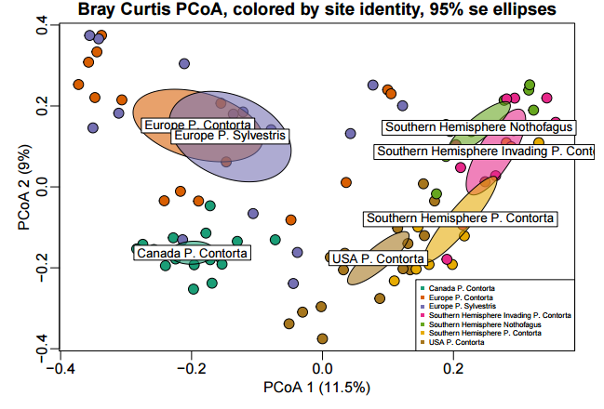
Beta Diversity is Structured by Location

Slide 9
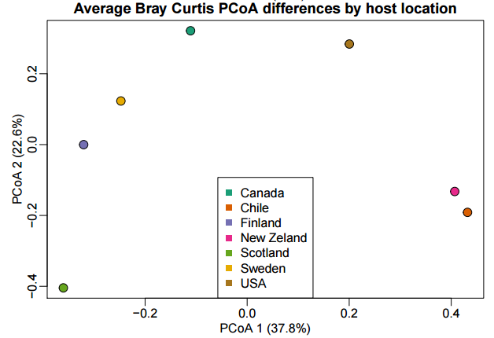
Beta Diversity is Structured by Location
PERMANOVA: R² = 0.25, p = 0.001

Slide 10
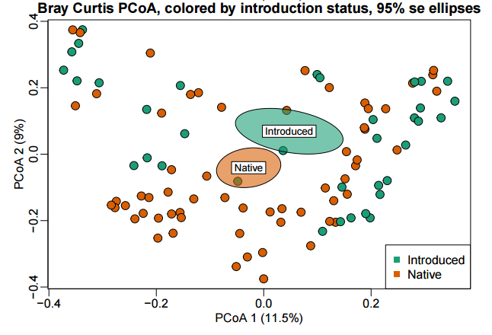
Beta Diversity is not Structured by Introduction Status
PERMANOVA: R² = 0.02, p = 0.001

Slide 11
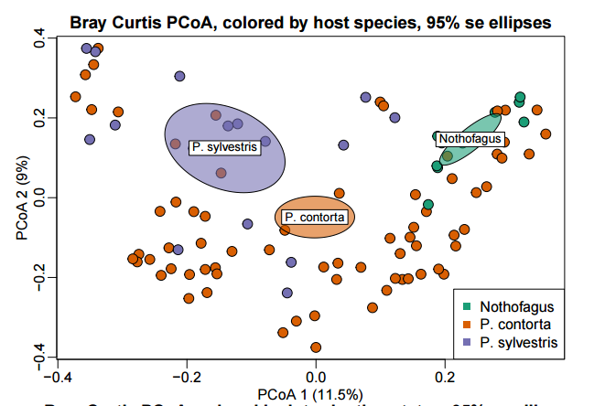
Beta Diversity is not Structured by Host Species
PERMANOVA: R² = 0.07, p = 0.001

Slide 12
Conclusions
Host location has largest effect on structuring endophyte communities
Introduction status and species do not significantly affect community structure

Slide 13
Implications
Invasion success of P. contorta could be related to its ability to form, non-specific endophyte associations in introduced environment
Pinus contorta could benefit from positive plant-soil feedback
Contradicts eco-evolutionary pattern of phylosymbiosis – don’t see expected relationship of closely related hosts with most similar fungal communities

Slide 14
Future Directions
Does P. contorta benefit from a positive plant-soil feedback?
Are the microbial communities associated with these trees functionally similar?

Slide 15
Literature Cited
Gundale, M. J., Almeida, J. P., Wallander, H., Wardle, D. A., Kardol, P., Nilsson, M. C., ... & Mason, B. (2016). Differences in endophyte communities of introduced trees depend on the phylogenetic relatedness of the receiving forest. Journal of Ecology, 104(5), 1219-1232.

